Slide 1

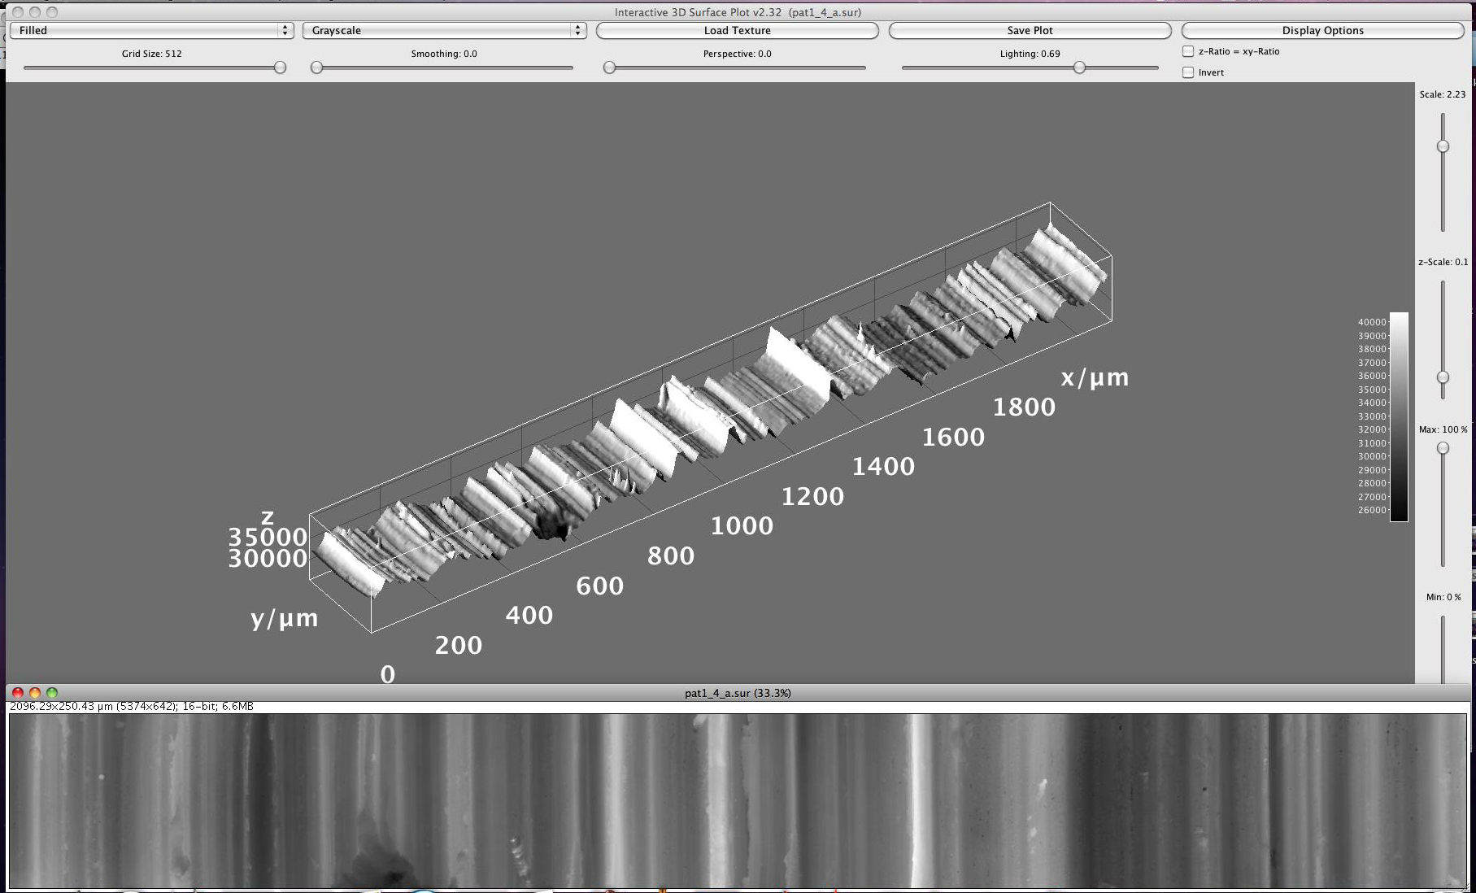


Hands-on Introduction to R

Slide 2
Outline
Mean, median, standard deviation, standard error of the mean
Using built in distributions
Confidence intervals
Hypothesis testing
Regression
Analysis of Variance

Slide 3
Measures of Central Tendency
Given a sample from some population:
What is a good “summary” value which well describes the sample and uncertainty?
We will look at:
Average (arithmetic mean)
Median
Mode
Standard deviation
Standard error of the mean
For reference see (available on-line):
“The Dynamic Character of Disguised Behaviour for Text-based, Mixed and Stylized Signatures”
LA Mohammed, B Found, M Caligiuri and D Rogers
J Forensic Sci 56(1),S136-S141 (2011)

Slide 4
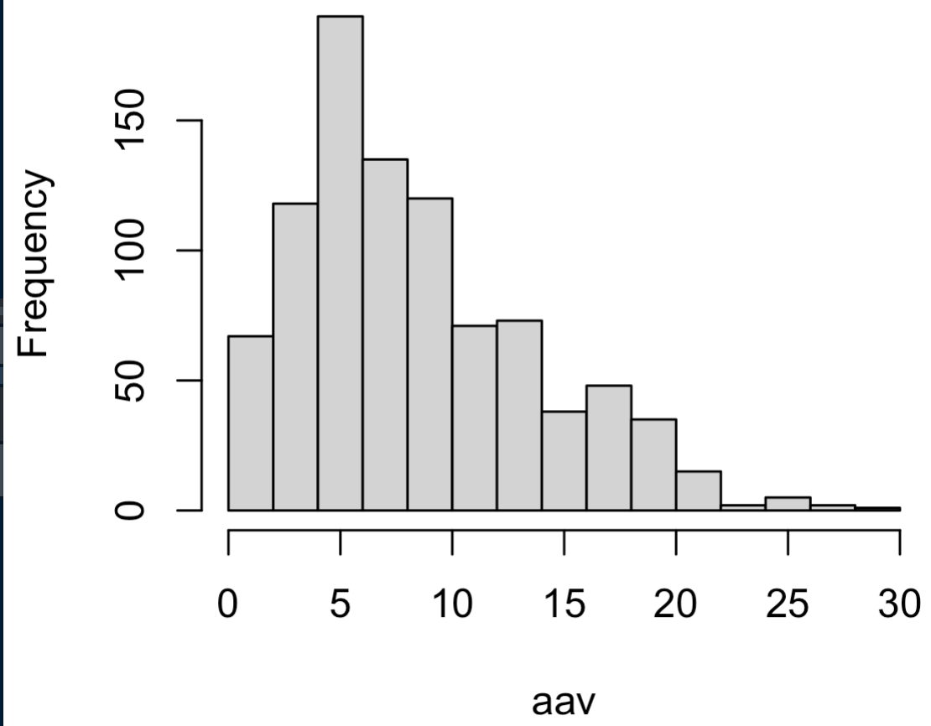
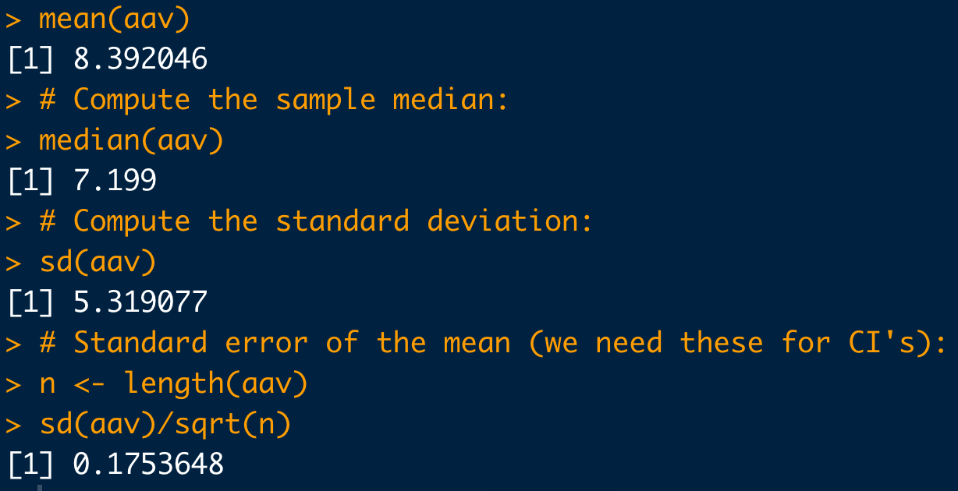
Basic Statistical Commands:
# Load data:
dat <- read.csv(
"https://raw.githubusercontent.com/npetraco/workshop21/master/data/lamwrite.csv", header=T)
head(dat)
dim(dat)
# Dump column 2 to a variable:
aav <- dat[,2]
# Look at the data:
hist(aav)
# Compute the sample mean:
mean(aav)
# Compute the sample median:
median(aav)
# Compute the standard deviation:
sd(aav)
# Standard error of the mean (we need these for CI's):
n <- length(aav)
sd(aav)/sqrt(n)

Slide 5
Built in Probability Distributions
R has many built in discrete and continuous probability distributions
Each built in R distribution has:
A name:
Binomial: binom
Poisson: pois
Uniform: unif
Gaussian: norm
Four functions to deal with:
Likelihood/density values: “d-function”
Cumulative Probability: “p-function”
Quantiles: “q-function”
Random sampling: “r-functions”
These are the most commonly used

Slide 6
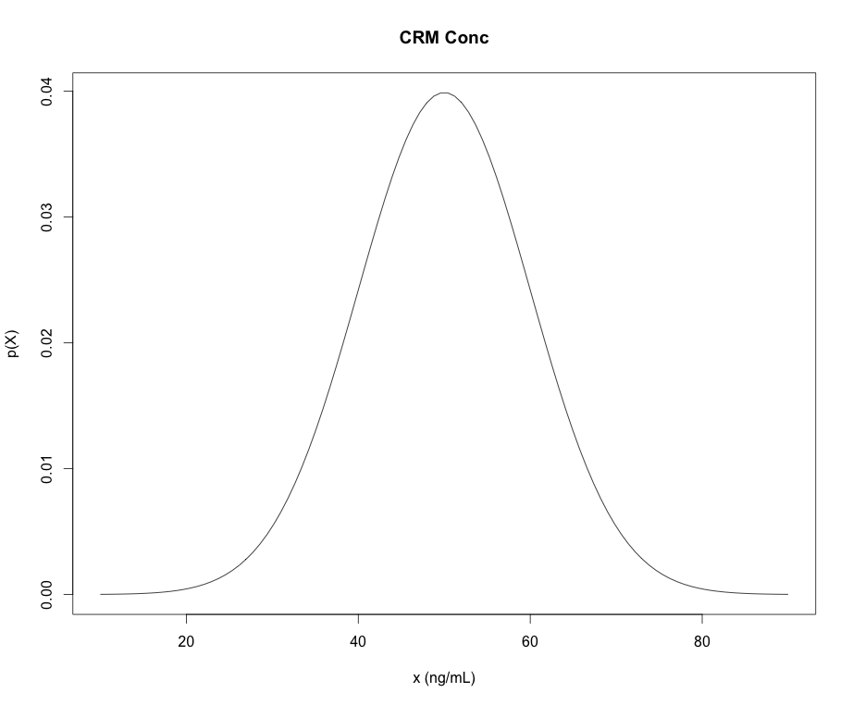
Example of a Named Distribution: Gaussians
dnorm “d-function” in R is the density (mass) of the distribution
pnorm “p-function” in R is the CDFs of the distribution
qnorm “q-function” in R give the quantiles of the distribution (x-values) for a given cumulative probability (p-value)
rnorm “r-functions” in R gives a random sample from the distribution
*NOTE: “p-functions” and “q-functions” are inverses of each other
pnorm(q=47,mean=50,sd=10)=
0.42
0.42
“input quantity”
qnorm(p=0.42,mean=50,sd=10)=
47
47

Slide 7
Example: quantiles/percentiles with Continuous PDFs
The concentration is certified to follow a normal distribution with mean concentration of 50 ng/mL and standard deviation of 10 ng/mL.
?

Slide 8
Example: quantiles/percentiles
What is the probability that a CRM’s concentration will be measured to be between 30 ng/mL and 70 ng/mL?
R does the “calculus” for you
30 ng/mL
70 ng/mL
# The “measurands” (parameters):
mu <- 50
sigma <- 10
# Pr(30 <= X <= 70):
pnorm(70, mean=mu, sd=sigma) – pnorm(30, mean=mu, sd=sigma)

Slide 9
Example: quantiles/percentiles with Continuous PDFs
What maximum concentration can we expect for 90% of the samples we may measure?
0.9
What’s the quantile corresponding to 0.9?

Slide 10
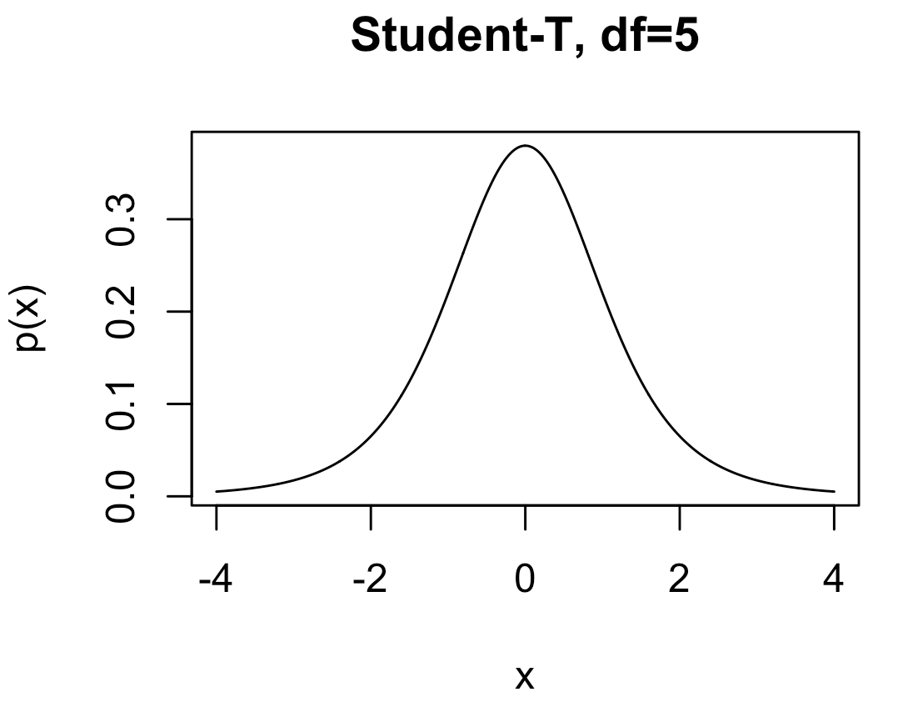
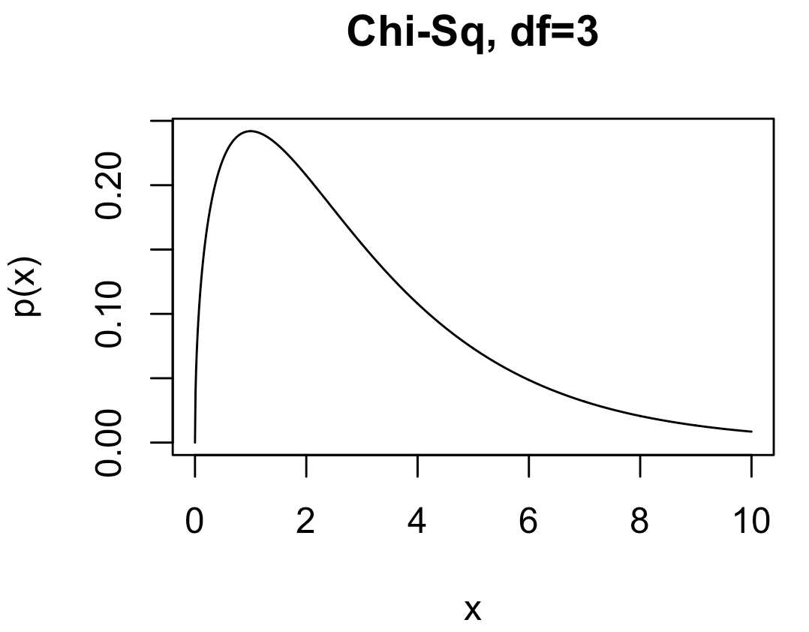
Other Common Distributions
Student-t: Like a standard normal distribution but fatter tails.
dt, qt, pt, rt
Parameters:
df: degrees of freedom
Chi-squared (χ²): Handy especially for comparing raw set of counts. Also, it’s proportional to the likelihood of sample variance for IID data.
dchisq, qchisq, pchisq, rchisq
Parameters:
df: degrees of freedom

Slide 11
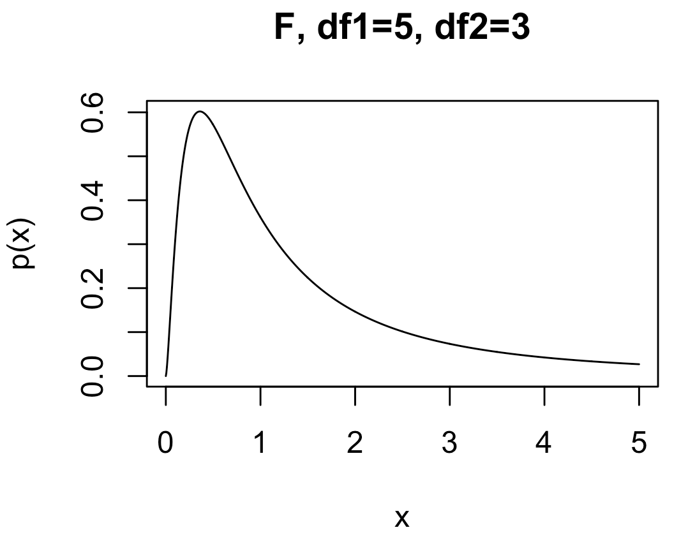
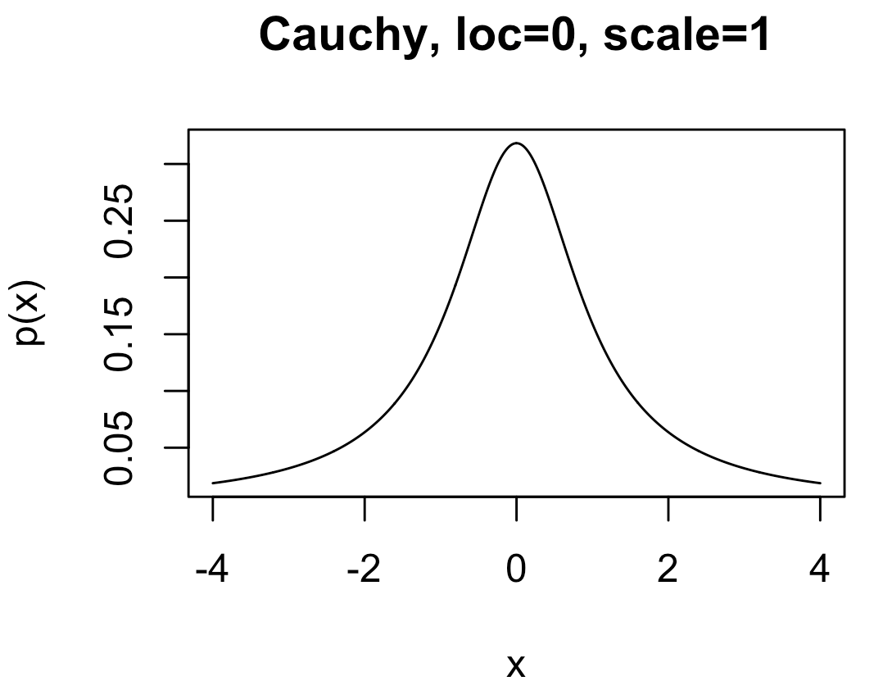
Other Common Distributions
F : Handy especially for comparing outcomes in three or more experiments with different conditions.
df, qf, pf, rf
Parameters:
df1: degrees of freedom 1
df2: degrees of freedom 2
Cauchy : A very fat-tailed distribution. Handy for expressing lots of uncertainty when modeling, while retaining formal properties of a proper probability distribution
dcauchy, qcauchy, pcauchy, rcauchy
Parameters:
location: peak location of the density
scale: “fat-ness” of the tails

Slide 12
Confidence Intervals
Construction of a CI for a mean depends on:
Sample size n
Standard error for means
Level of confidence 1-α
α is significance level
Use α to compute t_{c}-value, the critical t-statistic
(1-α)×100% two-sided CI for population mean using a sample average and standard error is:

Slide 13
Confidence Intervals
Compute the 95% confidence interval for the mean average absolute velocity in the LAM data
# Load data:
dat <- read.csv(
"https://raw.githubusercontent.com/npetraco/workshop21/master/data/lamwrite.csv",
header=T)
# Average absolute velocity data:
aav <- dat[,2]
n <- length(aav) # sample size
xbar <- mean(aav) # sample mean
se <- sd(aav)/sqrt(n) # standard error of the sample mean
conf <- 0.95 # level of confidence
alpha <- 1 - conf # level of significance
tc <- qt(1 - alpha/2, df = n-1) # tc for a two-sided CI
xbar.lo <- xbar - tc*se
xbar.hi <- xbar + tc*se
c(xbar.lo, xbar.hi) # Condifence interval for the mean

Slide 14
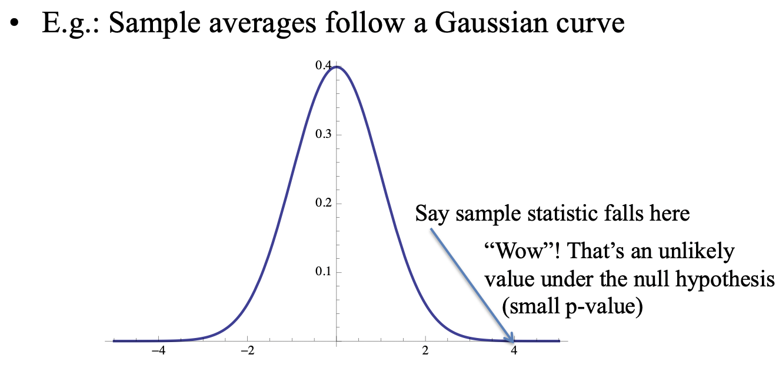
Hypothesis Testing
A hypothesis is an assumption about a statistic.
Form a hypothesis about the statistic
H₀, the null hypothesis
Identify the alternative hypothesis, H_{a}
“Accept” H₀ or “Reject” H₀ in favour of H_{a} at a certain confidence level (1-α)×100%
Technically, “Accept” means “Do not reject”

Slide 15
Example: One Sample Hypothesis Testing for the Mean
Consider a series of mass assays measurements (in grams) :
49.9996, 49.9994, 49.9993, 49.9996, 49.9995, 49.9995,49.9995, 49.9994, 49.9995, 49.9994
Do a 95% confidence hypothesis test to test if μ_{mass} ≠ 50.000g (H_{a}).
Do a 95% confidence hypothesis test to test if μ_{mass} < 50.000g (H_{a}).
Do a 95% confidence hypothesis test to test if μ_{mass} > 50.000g (H_{a}).

Slide 16
Example: One Sample Hypothesis Testing for the Mean
# Question of interest: Is the mean mass == 50.000g ?
x <- c(49.9996,49.9994,49.9993,49.9996,49.9995,49.9995,49.9995,49.9994,49.9995,49.9994)
mean(x)
# NULL HYPOTHESIS: mu == 50.000g
# ALTERNATIVE HYPOTHESIS: mu != 50.000g
t.test(x, alternative = "two.sided", mu = 50.000, conf.level = 0.95)
# The meaning of the output for t.test:
# Can we REJECT the NULL HYPOTHESIS? => Is there evidence that the mean mass is not equal to 50.000g?
# p-value = 2.704e-08
#
# So p < 0.05. REJECT the NULL HYPOTHESIS. The data is "unlikely" under the null.
# Another interperitation: If the Null were true, we wouldn't see data like this too often.
# BUT: We CANNOT SAY that the data is more likely under the Alternative hypothesis.
Η₀: μ_{mass} = 50.000g
Η_{a}: μ_{mass} ≠ 50.000g

Slide 17
Example: One Sample Hypothesis Testing for the Mean
# Question of interest: Is there evidence that the mean mass is less than 50.000g ?
x <- c(49.9996,49.9994,49.9993,49.9996,49.9995,49.9995,49.9995,49.9994,49.9995,49.9994)
mean(x)
# NULL HYPOTHESIS: mu >= 50.000g
# ALTERNATIVE HYPOTHESIS: mu < 50.000g
t.test(x, alternative = "less", mu = 50.000, conf.level = 0.95)
# The meaning of the output for t.test:
# Can we REJECT the NULL HYPOTHESIS? => Is there evidence that the mean mass is less than 50.000g?
# p-value = 1.352e-08
# So p < 0.05. REJECT the NULL HYPOTHESIS. The data is "unlikely" under the null.
# Another interperitation: If the Null were true, we wouldn't see data like this too often.
# BUT: We CANNOT SAY that the data is more likely under the Alternative hypothesis.
Η₀: μ_{mass} ≥ 50.000g
Η_{a}: μ_{mass} < 50.000g

Slide 18
Example: One Sample Hypothesis Testing for the Mean
# Question of interest: Is there evidence that the mean mass is greater than or equal to 50.000g ?
x <- c(49.9996,49.9994,49.9993,49.9996,49.9995,49.9995,49.9995,49.9994,49.9995,49.9994)
mean(x)
# NULL HYPOTHESIS: mu <= 50.000g Assumes the opposite of what you seek evidence for.
# ALTERNATIVE HYPOTHESIS: mu > 50.000g
t.test(x, alternative = "greater", mu = 50.000, conf.level = 0.95)
# The meaning of the output for t.test:
# Can we REJECT the NULL HYPOTHESIS? => Is there evidence that the mean mass is greater than 50.000g?
# p-value = 1 (Wow!)
# So p is not < 0.05. CANNOT REJECT the NULL HYPOTHESIS. The data is "likely" under the null.
# Another interperitation: If the Null were true, we would see data like this often.
Η₀: μ_{mass} ≤ 50.000g
Η_{a}: μ_{mass} > 50.000g

Slide 19
Example: Two Sample Hypothesis Testing for the Mean
Could the two sets of glass shards be from the same window?
RIs # 1: 1.53419 1.53275 1.53345 1.53267 1.53292 1.53332 1.53464 1.53299 1.53430 1.53550
RIs # 2: 1.53577 1.53606 1.53602 1.53544 1.53618 1.53604 1.53551 1.53572 1.53580 1.53567
Do a two sample 95% confidence hypothesis test to test if : μ_{RI #1} ≠ μ_{RI #2} (H_{a}).

Slide 20
Example: Two Sample Hypothesis Testing for equivalence of Means
# Question of interest: Could the two sets of glass shards be from the same window ?
# NULL HYPOTHESIS: RI1 == RI2
# ALTERNATIVE HYPOTHESIS: RI1 != RI2
# RIs of shards from glass pane 1
RI1 <- c(1.53419, 1.53275, 1.53345, 1.53267, 1.53292, 1.53332, 1.53464, 1.53299, 1.53430, 1.53550)
# RIs of shards from glass pane 2
RI2 <- c(1.53577, 1.53606, 1.53602, 1.53544, 1.53618, 1.53604, 1.53551, 1.53572, 1.53580, 1.53567)
# It helps to look at a box-and-whiskers plot for two-sample tests:
boxplot(RI1, RI2)
# *Check to see if (H0) variances of the two samples equal = 1 (i.e. evidence that vars are not equal??):
var.test(RI1, RI2)
# Two sample two sided hypothesis test for equivalence between means:
t.test(RI1, RI2, var.equal = FALSE, alternative = "two.sided", conf.level = 0.95)
Η₀: μ_{RI #1} = μ_{RI #2}
Η_{a}: μ_{RI #1} ≠ μ_{RI #2}

Slide 21
Basic Linear Regression
y
x

Slide 22
Example: Basic Linear Regression
Consider the Manganese and Zirconium content for sets of different kinds of glass bottles^{Curran}
Manganese Data (Mn)
56.1, 53.8, 58.7, 54.6, 58.6, 56.8, 54.6, 59.2, 54.9, 61.1, 59.4, 54.9, 58.7, 55.3, 61.7, 59.7, 56.3, 59.8, 53.6, 60.6,
58.6, 52.5, 61.2, 54, 61.7, 59, 53.9, 61.5, 57.4, 60.5, 65.8, 55, 60.8, 56.4, 63.4, 65.4, 55.9, 59.7, 56.9, 63.4,
65.2, 55.1, 61.6, 58.7, 63.8, 64.7, 56.6, 60.9, 57.8, 63.5, 64.1, 57.4, 61.2, 57.4, 65, 64.8, 56.7, 60.3, 57.6, 64.3,
66, 57.5, 61.5, 58, 65.3, 67.2, 56.3, 60.3, 57.4, 66.4, 67.9, 55.2, 63, 58, 65.2, 66.1, 57.7, 63.3, 58.7, 64,
52.7, 43.5, 49.8, 47, 52.1, 50.2, 41.8, 48.6, 44.9, 51.1, 50.8, 45.2, 49, 44.6, 50.9, 52.3, 43.3, 48.8, 45.5, 52,
65.1, 57.4, 64.5, 59.3, 66.5, 66.6, 56.8, 62.6, 59, 67.8, 65.7, 56.6, 62.4, 57.9, 67.2, 64.9, 52.4, 61.9, 57.8, 63.9
Zirconium Data (Zr)
77.4, 71.6, 78.2, 75.3, 83.9, 79.2, 74.6, 78.9, 80.2, 90.2, 77.6, 70.3, 74.7, 72.4, 83.4, 78.3, 71.4, 79.4, 78.0, 82.7,
85.8, 80.0, 90.8, 88.0, 99.2, 85.1, 70.3, 80.0, 77.7, 84.8, 86.3, 70.2, 80.6, 79.9, 86.8, 84.5, 71.4, 79.6, 78.4, 86.8,
93.3, 81.4, 91.4, 86.5, 99.0, 100.9, 88.0, 95.1, 94.4, 109.4, 89.5, 79.3, 87.1, 85.3, 98.5, 100.4, 83.7, 89.5, 93.8, 106.7,
102.6, 85.9, 91.7, 93.4, 109.4, 111.4, 93.4, 101.1, 103.6, 118.7, 92.9, 77.1, 84.1, 84.0, 100.1, 97.5, 82.9, 94.6, 91.4, 102.2,
63.1, 51.2, 59.1, 57.0, 65.6, 74.0, 60.1, 70.9, 68.8, 79.8, 56.6, 50.0, 58.3, 56.2, 69.5, 67.3, 55.6, 64.2, 63.9, 75.4,
101.5, 84.0, 96.5, 91.0, 109.6, 81.4, 70.6, 81.1, 79.7, 91.0, 116.6, 94.2, 109.8, 108.5, 125.7, 81.5, 67.8, 80.8, 77.9, 90.9

Slide 23
Example: Basic Linear Regression
Compute a best fit line to the data of Mn vs Zr and report:
a. The slope coefficient,
b. The intercept coefficient,
c. Is the slope coefficient significant at, at least the 95% level of confidence?
d. Is the intercept coefficient significant at, at least the 95% level of confidence?
e. The standard error of the residuals,
f. The Adjusted R-squared correlation coefficient

Slide 24
Example: Basic Linear Regression
# Load the data Mn = x, Zr = y:
x <- c(
56.1, 53.8, 58.7, 54.6, 58.6, 56.8, 54.6, 59.2, 54.9, 61.1,
59.4, 54.9, 58.7, 55.3, 61.7, 59.7, 56.3, 59.8, 53.6, 60.6,
58.6, 52.5, 61.2, 54, 61.7, 59, 53.9, 61.5, 57.4, 60.5,
65.8, 55, 60.8, 56.4, 63.4, 65.4, 55.9, 59.7, 56.9, 63.4,
65.2, 55.1, 61.6, 58.7, 63.8, 64.7, 56.6, 60.9, 57.8, 63.5,
64.1, 57.4, 61.2, 57.4, 65, 64.8, 56.7, 60.3, 57.6, 64.3,
66, 57.5, 61.5, 58, 65.3, 67.2, 56.3, 60.3, 57.4, 66.4,
67.9, 55.2, 63, 58, 65.2, 66.1, 57.7, 63.3, 58.7, 64,
52.7, 43.5, 49.8, 47, 52.1, 50.2, 41.8, 48.6, 44.9, 51.1,
50.8, 45.2, 49, 44.6, 50.9, 52.3, 43.3, 48.8, 45.5, 52,
65.1, 57.4, 64.5, 59.3, 66.5, 66.6, 56.8, 62.6, 59, 67.8,
65.7, 56.6, 62.4, 57.9, 67.2, 64.9, 52.4, 61.9, 57.8, 63.9
)
y <- c(
77.4, 71.6, 78.2, 75.3, 83.9, 79.2, 74.6, 78.9, 80.2, 90.2,
77.6, 70.3, 74.7, 72.4, 83.4, 78.3, 71.4, 79.4, 78.0, 82.7,
85.8, 80.0, 90.8, 88.0, 99.2, 85.1, 70.3, 80.0, 77.7, 84.8,
86.3, 70.2, 80.6, 79.9, 86.8, 84.5, 71.4, 79.6, 78.4, 86.8,
93.3, 81.4, 91.4, 86.5, 99.0, 100.9, 88.0, 95.1, 94.4, 109.4,
89.5, 79.3, 87.1, 85.3, 98.5, 100.4, 83.7, 89.5, 93.8, 106.7,
102.6, 85.9, 91.7, 93.4, 109.4, 111.4, 93.4, 101.1, 103.6, 118.7,
92.9, 77.1, 84.1, 84.0, 100.1, 97.5, 82.9, 94.6, 91.4, 102.2,
63.1, 51.2, 59.1, 57.0, 65.6, 74.0, 60.1, 70.9, 68.8, 79.8,
56.6, 50.0, 58.3, 56.2, 69.5, 67.3, 55.6, 64.2, 63.9, 75.4,
101.5, 84.0, 96.5, 91.0, 109.6, 81.4, 70.6, 81.1, 79.7, 91.0,
116.6, 94.2, 109.8, 108.5, 125.7, 81.5, 67.8, 80.8, 77.9, 90.9
)

Slide 25
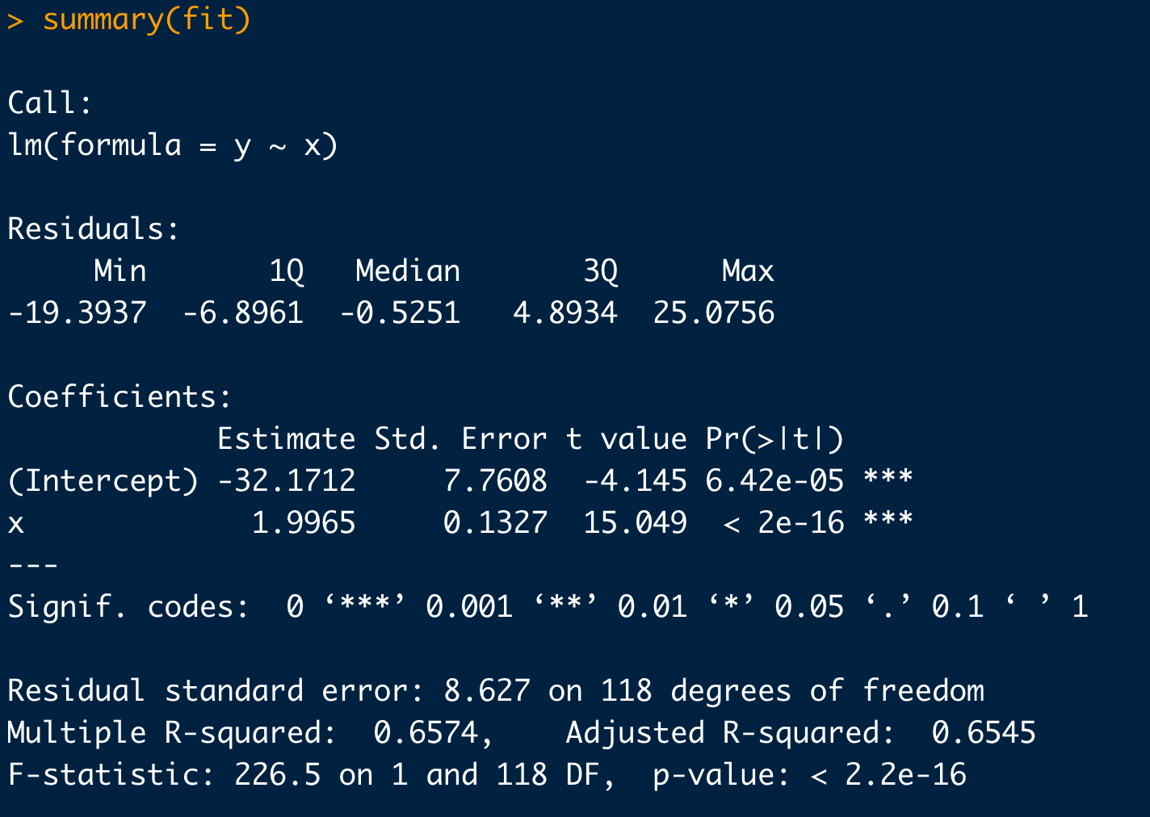
Example: Basic Linear Regression
# Take a look at your data first:
plot(x,y)
# Simple linear regression:
fit <- lm(y ~ x)
summary(fit)
# Plot in your regression line:
plot(x,y)
abline(fit)
slope is significant at 95%
intercept is significant at 95%
Adjusted R²

Slide 26
Example: Basic Linear Regression
# Check your regression diagnostics (i.e. the behavior of the residuals):
eps <- residuals(fit)
hist(eps)
# Do the residuals look N(0, eps)-ish?:
qqnorm(eps)
qqline(eps)

Slide 27
Analysis of Variance
Standard hypothesis testing is great for comparing one or two sample means.
What if we have more than two sample group means to compare?
Use analysis of variance (ANOVA)
H₀ for ANOVA
The means of the groups being compared are not statistically different at the (1-α)×100% level of confidence
H_{a} for ANOVA
At least one of the group means is statically distinct.

Slide 28
Example
Consider the shotgun spread data (square-root area) as a function of range below:
10 feet
20 feet
30 feet
40 feet
50 feet
2.60, 3.35, 3.33, 3.06, 3.38, 3.85, 3.01, 3.02, 3.29, 3.00, 3.20, 3.11
6.84, 6.32, 6.96, 5.85, 5.95, 6.29, 5.57, 5.00, 5.42, 5.73, 5.29, 5.10
6.51, 6.72, 8.24, 7.38, 9.84, 9.42, 8.09, 6.80, 7.95, 8.62, 8.41, 8.62, 9.23
10.28, 11.47, 14.10, 12.54, 16.13, 11.03, 10.81, 10.19, 13.01, 11.17, 11.33, 9.35
11.80, 13.74, 5.18, 20.13, 16.94, 14.09, 16.07, 14.90, 17.47, 14.21, 13.13, 11.93
Use ANOVA to test for evidence of a significant difference between at least one of the treatment means

Slide 29
Example
# Data (responses)
y <- c(
2.60,3.35,3.33,3.06,3.38,3.85,3.01,3.02,3.29,3.00,3.20,3.11,
6.84,6.32,6.96,5.85,5.95,6.29,5.57,5.00,5.42,5.73,5.29,5.10,
6.51,6.72,8.24,7.38,9.84,9.42,8.09,6.80,7.95,8.62,8.41,8.62,9.23,
10.28,11.47,14.10,12.54,16.13,11.03,10.81,10.19,13.01,11.17,11.33,9.35,
11.80,13.74, 5.18,20.13,16.94,14.09,16.07,14.90,17.47,14.21,13.13,11.93
)
# Treatment labels for each data point
lbl <- c(
10, 10, 10, 10, 10, 10, 10, 10, 10, 10, 10, 10,
20, 20, 20, 20, 20, 20, 20, 20, 20, 20, 20, 20,
30, 30, 30, 30, 30, 30, 30, 30, 30, 30, 30, 30, 30,
40, 40, 40, 40, 40, 40, 40, 40, 40, 40, 40, 40,
50, 50, 50, 50, 50, 50, 50, 50, 50, 50, 50, 50
)
# Box plots to visually compare treatments:
boxplot(y ~ as.factor(lbl), range=0 )
# Quick look at the treatment means we will test
tapply(y, lbl, mean)
# R can handle all the ANOVA calculations automatically:
fit <- aov(y ~ as.factor(lbl))
summary(fit)

Slide 30
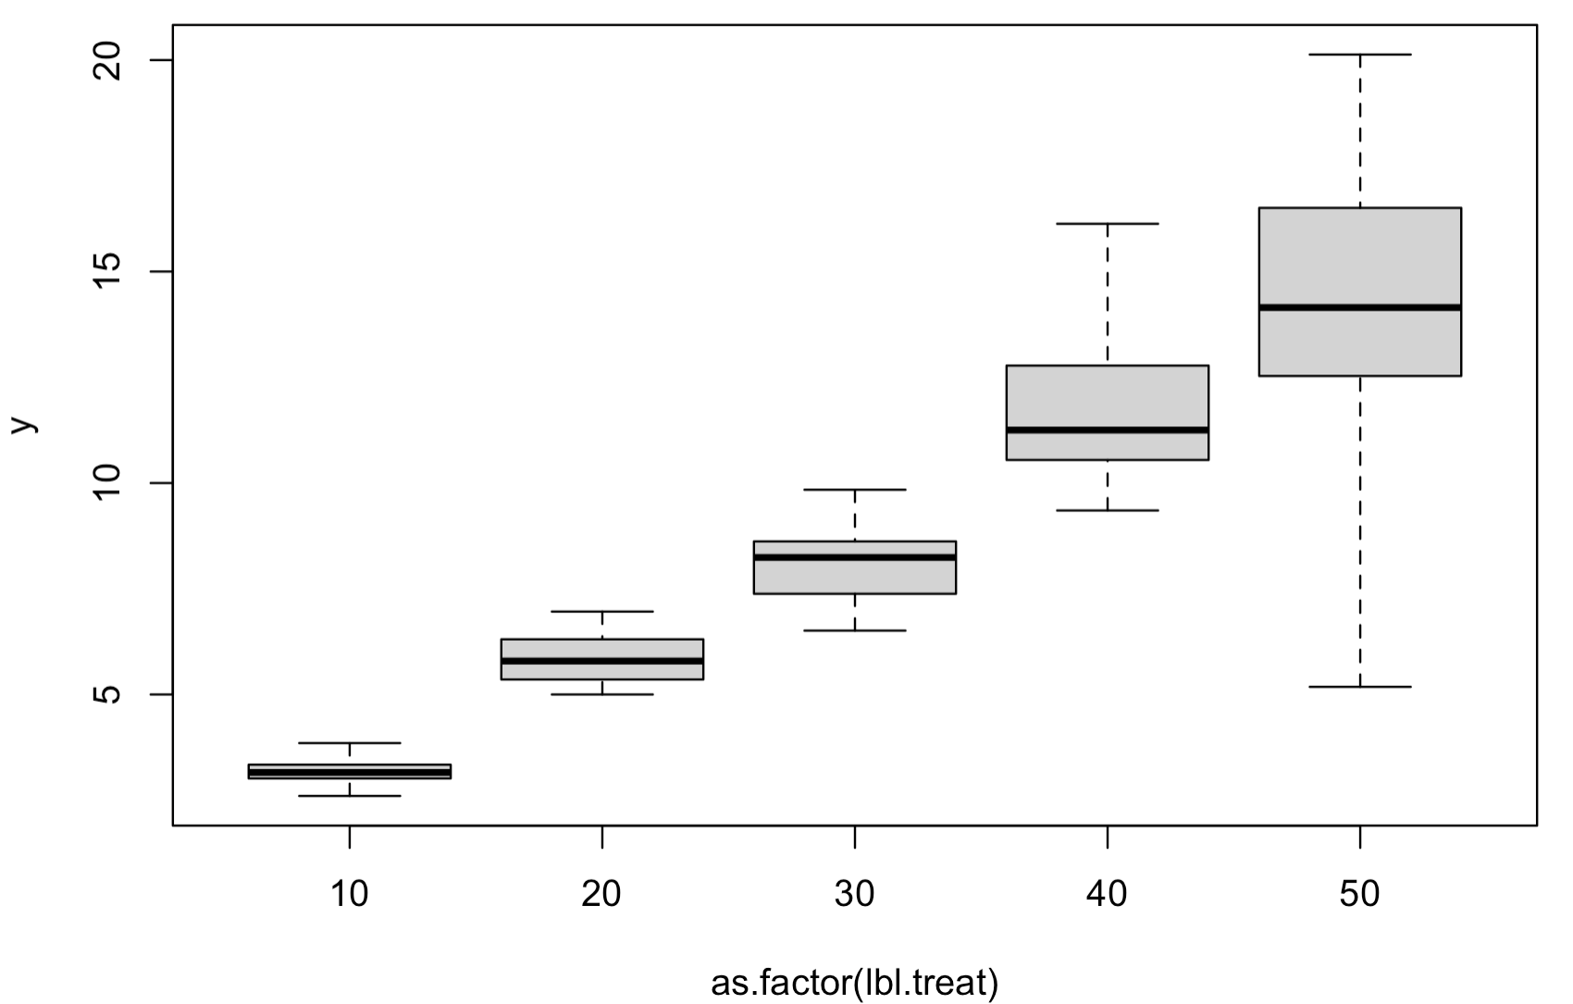
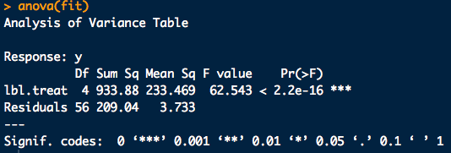
Example

Slide 31
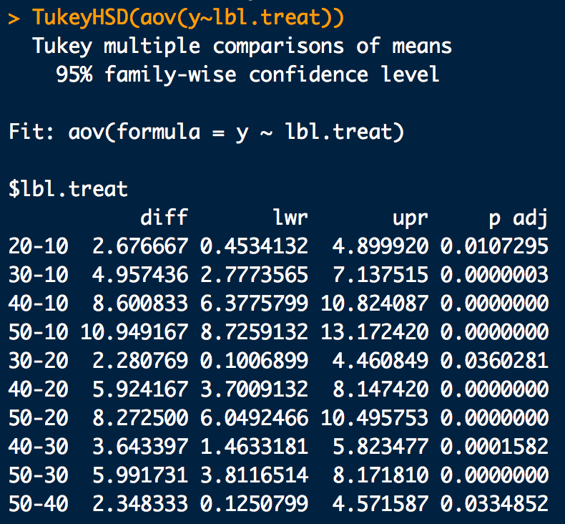
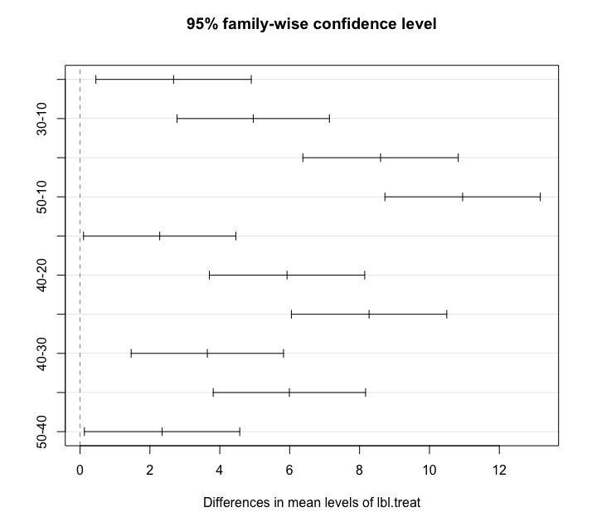
Tukey HSD Example
# Find a significant result from ANOVA? Do a Tukey HSD:
fit.tukey <- TukeyHSD(fit)
fit.tukey # Tukey test outputs
plot(fit.tukey) # Graphical version

